Slide 1
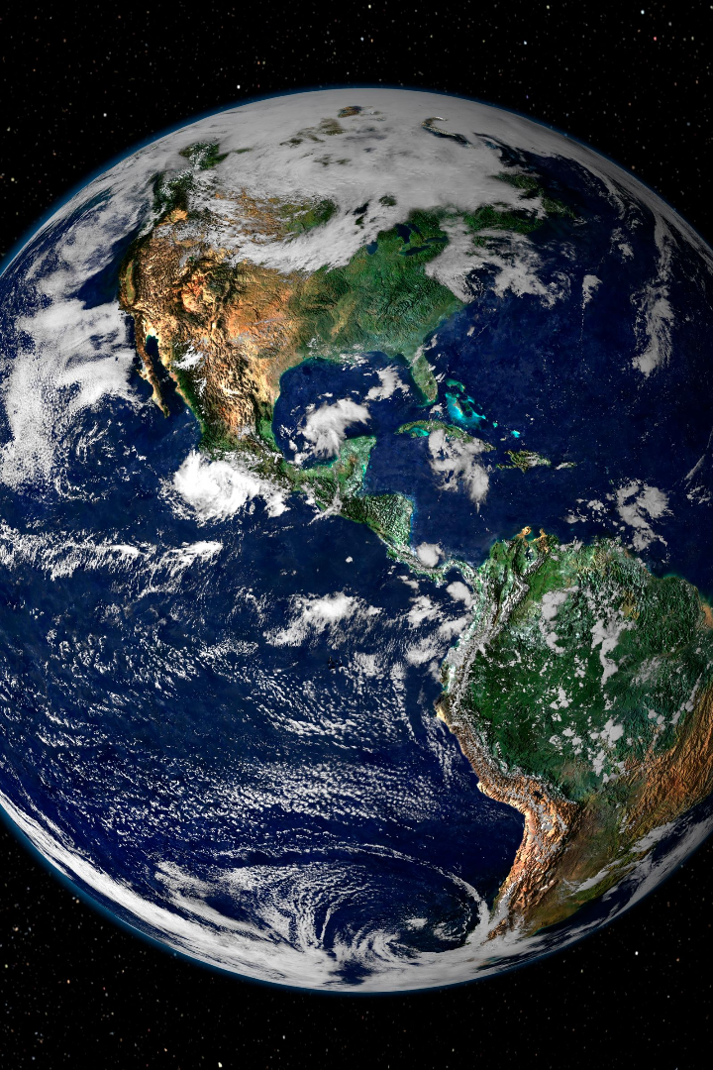

Introduction to Geography
Geography is the study of Earth and its features, including population, land use, and natural resources. It's essential in today's society to understand the world we live in.
DD
by Dimple Dhir

Slide 2
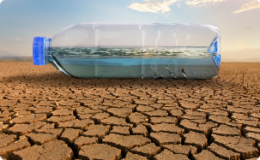

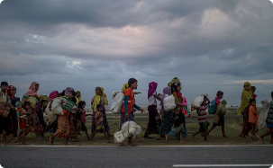
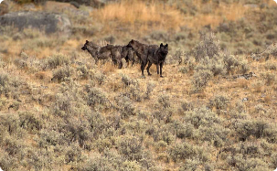
The Importance of Geography
Environmental Issues
Global Economy
Social Justice
Geography provides insight into the complexities of environmental issues, such as climate change and water scarcity.
Geography helps us understand the importance of international trade and how different regions of the world are interconnected.
Geography shines a light on social justice issues like migration patterns, demographics, and economic disparities.
Biodiversity
Geography is crucial to understanding the impact of human activities on the environment and the preservation of biodiversity.

Slide 3
Branches of Geography
Physical Geography
Human Geography
The study of natural features on earth, such as landforms, climate, and hydrology.
The study of human-made features on earth, such as population, culture, and industry.
Geographic Information Science
Environmental Geography
The science of developing and analyzing geographic data, such as maps and satellite images.
The study of the interactions between humans and the environment, including natural resource management and pollution.

Slide 4
Earth's Structure
Hydrosphere
The Earth's water, including oceans, rivers, lakes, and groundwater.
1
2
3
Lithosphere
Biosphere
The solid, outermost shell of the Earth made up of the crust and the uppermost part of the mantle.
The regions of the Earth's surface and atmosphere where living organisms exist.

Slide 5
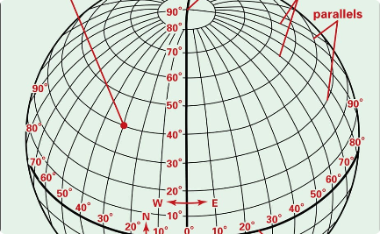
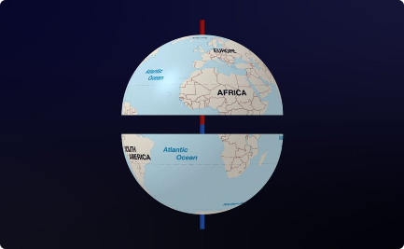
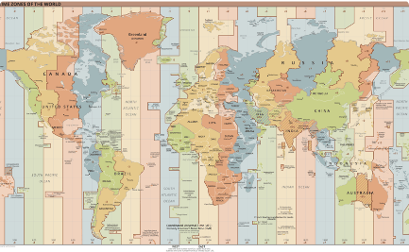
Earth's Grid System
Latitude & Longitude
Hemispheres
Time Zones
The grid system used to locate points on Earth's surface.
Divisions of the Earth's surface based on the equator and prime meridian.
Divisions of the Earth's surface based on longitude lines that determine time differences.

Slide 6
Map Reading and Interpretation
1
Title and Scale
2
Legend and Symbols
3
Orientation and Direction
Understanding a map's title and scale is critical to interpreting it accurately.
Knowing the meaning of symbols used on a map is essential to interpreting it accurately.
Knowing the cardinal directions and understanding how they relate to a map is important.

Slide 7
Cartography
Types of Maps
Map Projection
GIS Mapping
There are many different types of maps, including political, physical, topographic, and thematic.
Map projection is the process of converting a three-dimensional globe into a two-dimensional map. Different projections have different distortions.
GIS mapping is a digital process used to create maps and analyze geographic data.

Slide 8
Climate and Weather
Weather
The short-term conditions of the atmosphere in a specific location at a particular time. Weather is influenced by climate, atmospheric pressure, and other factors.
1
2
3
Climate
Climate Change
The long-term average of weather conditions in a certain region. Climate depends on factors such as temperature, precipitation, and wind patterns.
The long-term alteration of Earth's climate due to human activities such as burning fossil fuels and deforestation.

Slide 9
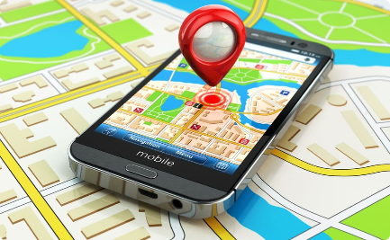
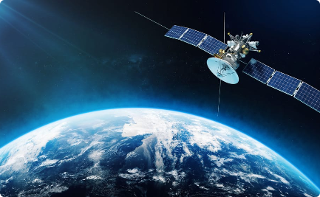

Geographical Tools and Techniques
Global Positioning System (GPS)
Satellite Imagery
3D Modeling
Photographs taken from space used to study the Earth's surface for various purposes.
Using computer technology to create a three-dimensional representation of the Earth's surface.
Uses satellites to determine location accurate to within a few meters.

Slide 10

Conclusion
Geography is a vital discipline that helps us to understand our world better. With its focus on natural resources, human society and other disciplines, geography plays a crucial role in shaping our world now and in the future.

