Slide 1
OOP’ s in Java
Presented By:
Asst. Prof. Navjeet Kaur
Computer Department
Govt College Ropar

Slide 2
Introduction of java
Java is a general-purpose computer programming Language.
It is a subset of C and C++.
Developed James Gosling in Sun Microsystems Labs USA in 1995.
Java, initially called Oak after an oak tree that stood outside Gosling's office.

Slide 3
Where it is used?
Desktop Applications such as media player, antivirus etc.
Web Applications such as irctc.co.in, javatpoint.com etc.
Enterprise Applications such as banking applications.
Mobile
Embedded System
Smart Card
Robotics
Games etc.

Slide 4
Types of Java Applications
Standalone Application
It is also known as desktop application such as media player, antivirus etc
Web Application
It is also known as dynamic page that runs on the server side
Enterprise Application
An application that is distributed in nature, such as banking applications etc.
Mobile Application
An application that is created for mobile devices. Like currently Android and Java ME

Slide 5
Features of Java
Simple
Platform independent
Secured
Robust
Portable
Reliable
High Performance
Architectural Neutral

Slide 6
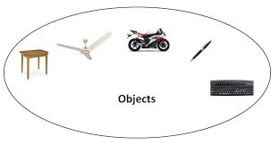
Object-Oriented :Its features are:
Object
Any entity that has state and behavior is known as an object. For example: chair, pen, table, keyboard, bike etc

Slide 7
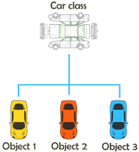
Class
Collection of objects is called class. It is a logical entity.

Slide 8
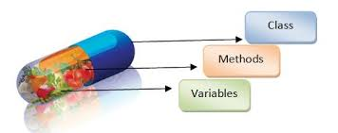
DATA ABSTRACTION AND ENCAPSULATION:
Combining data(variabl) and functions(methods) into a single unit called class and the process is known as Encapsulation.

Slide 9
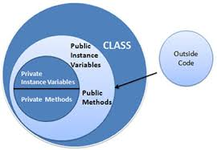
Encapsulation
It binds together the data and functions that manipulate the data, and that keeps both safe from outside interference and misuse.

Slide 10
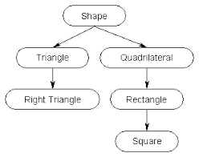
Inheritance
It is a mechanism in which one object acquires all the properties and behaviors of parent object.

Slide 11
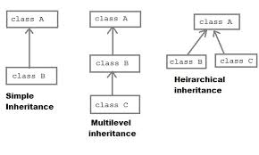
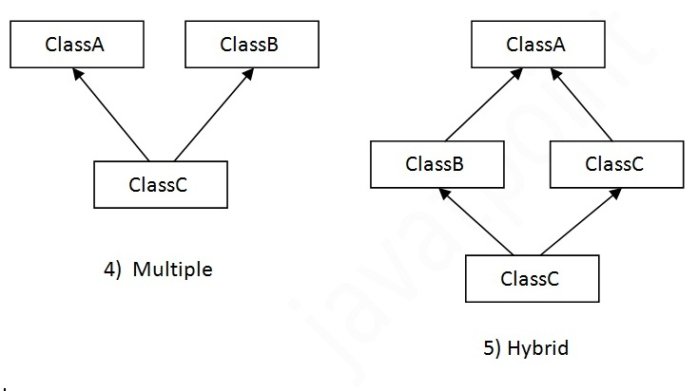
Types of inheritance
Single Inheritance
Multilevel Inheritance
Multiple Inheritance
Hybrid Inheritance
Hierarchical Inheritance

Slide 12
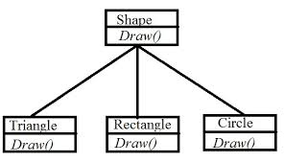
Polymorphism
Polymorphism is the ability of an object to take on many forms.

Slide 13
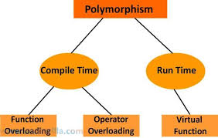
Types of Polymorphism
Compile Time
Run Time

Slide 14
Thanks

